Slide 1
Machine Learning Models for Predicting Protein-Protein Interactions.
Group-No : 2
Nithya -23021
Vishnu -23043
Sreekar -23049
Beena -23065

Slide 2
Problem Statement
Understanding the Protein-Protein interactions
Identifying these interactions experimentally is costly, time-consuming, and often limited in scale, leading to incomplete interaction networks.
The challenge is by using the available biological data such as amino acid sequences, structural information etc. We need to create a computational model that predicts the potential PPIs accurately

Slide 3
Basic Terminology
What is Protein-Protein interaction ?
The interaction or physical contact between two are more protein molecules in a biological space.
What is Docking ?
The initial contact between the protein molecules to bind them together for further interactions.

Slide 4
Objective
The Objective of this project is to create machine learning model the predicts the potential PPIs by using the biological data available.
They do have huge complex structure that makes the computation model to feel the difficulty to understand the site used to bind between the to protein molecules.
It also should predict the potential one.

Slide 5
Goals of this Project
Data Collection and Preprocessing
Compile a comprehensive and diverse set of biological data, including known PPI datasets and other relevant features.
Model Evaluation and Validation
Rigorously evaluate the performance of the developed models using cross-validation and relevant performance metrics

Slide 6
Applications
Drug Discovery and Development
Understanding Disease Mechanisms
Cancer Research
Evolutionary Biology

Slide 7
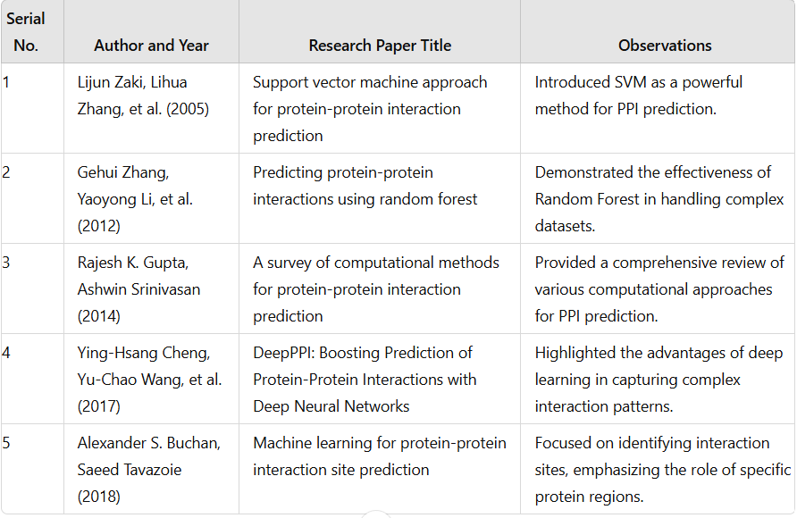

Slide 8
Conclusion
By this project a developed and an advanced application in machine learning that predicts the potential PPIs accurately.
We are also going to get some solutions to various types of applications with implications for drug discovery, disease understanding, and basic biological research.

Slide 9
THANK YOU

